Slide 1
internet safety education for youth: using research to build better programs
Lisa M. Jones
Crimes against Children Research Center
University of New Hampshire

Slide 2
Overview
Rates of Internet safety problems
  Harrassment/Cyberbullying
  Sexting
  Internet Predators
Risk Factors
Implications for Internet Safety Education

Slide 3
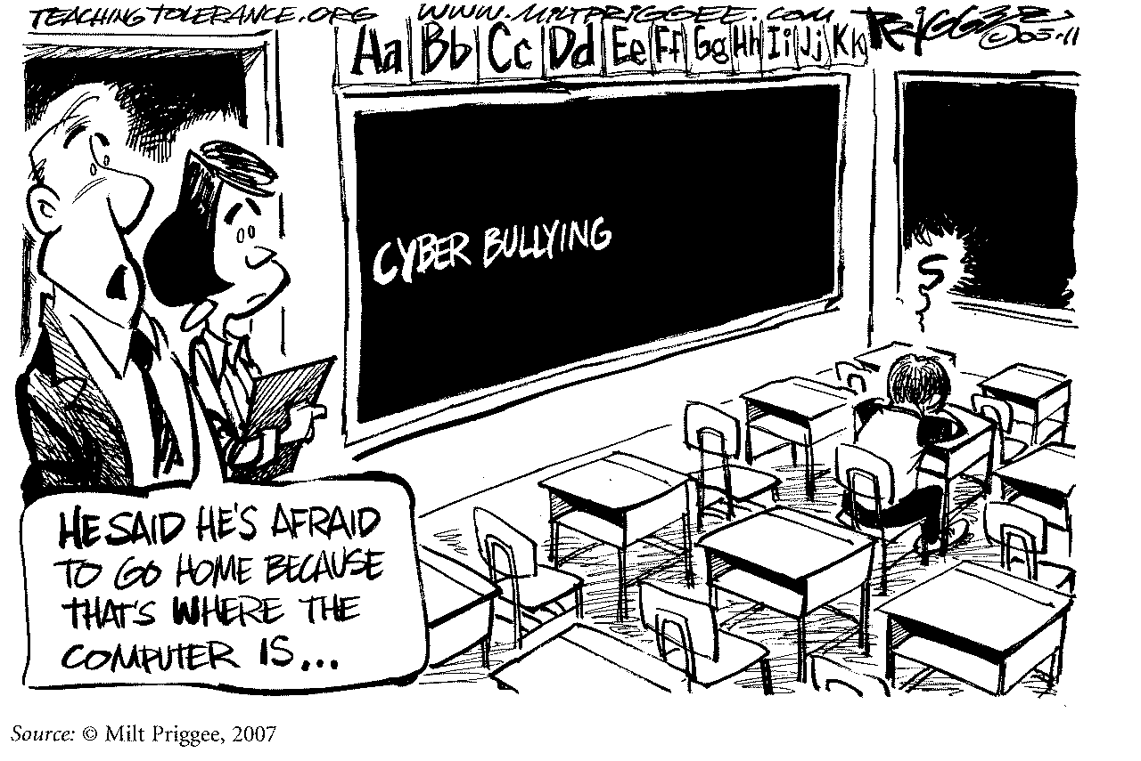
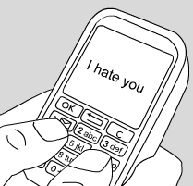
HARRASSMENT/CYBERBULLYING

Slide 4
Harassment/Cyberbullying
Rates based on research range from 6% to 72% of kids involved in cyberbullying as targets or contributors
Numbers vary because of
  Sample
  Timeframe
  How questions are asked/Number of questions
Notes:
Terms often used interchangeably but there are some key differences….

Slide 5
Harassment/Cyberbullying
DEFINITIONAL ISSUES
Harassment
  Threats or other offensive behavior sent online to the youth or posted online about the youth for others to see
Cyberbullying
  Overlaps with harassment but requires:
    Harmful intent
    Repetition
    Power imbalance
Notes:
Terms often used interchangeably but there are some key differences….

Slide 6
Harassment/Cyberbullying
Youth Internet Safety Survey (2005)
  Youth who reported being targets of harassment increased from 6% in 1999 to 9% in 2005 (Mitchell, Wolak, Finkelhor, 2006).
  43% by known peers; 56% by people they met online
  25% of incidents by peers and 21% of online only contacts involved repeated incidents and either distress or adult intervention (Wolak, Mitchell, Finkelhor, 2007).

Slide 7
Harassment/Cyberbullying
NIH study (Wang et al, 2009)
  Rates of being involved in cyberbullying in last 2 months: 14% (8% targets and 10% aggressor)
Hinduja &Patchin, 2009
  19% report at least one type of harassment happening 2 or more times in last 30 days (spread rumors, posted a mean or hurtful comment, etc.)

Slide 8
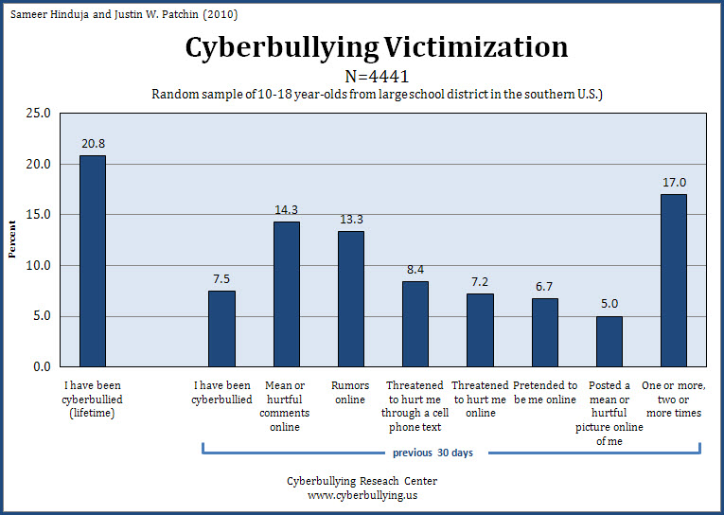
Harassment/Cyberbullying

Slide 9
Harassment/Cyberbullying
Risk Factors for Targets:
  Social problems
  Interpersonal victimization
  Depressive symptomatology among boys
  Poor academic functioning
  Harassing others
Risk Factors for Aggressors:
  Rule breaking problems
  Physical / sexual abuse for girls
  Poor emotional bond with caregiver
  Alcohol and cigarette use
  Low school commitment

Slide 10
Harassment/Cyberbullying
EMOTIONAL EFFECTS
  39% of youth who are harassed report feeling very/extremely upset or afraid because of the incident (Ybarra, Mitchell, Wolak, Finkelhor, 2006)
  Youth who experience either bullying or cyberbullying have more suicidal thoughts and are more likely to attempt suicide (Hinduja & Patchin, in press)

Slide 11
Harassment/Cyberbullying
PUTTING IT IN CONTEXT
We don’t know yet whether cyberbullying is more distressing to targets than in-person bullying
The term “cyberbullying” may not accurately reflect the nature of much online harassment behavior
While online harassment incidents may be increasing, data show that bullying in general is down among youth

Slide 12


SEXTING

Slide 13
SEXTING
From 12/20/09 Today Show article on Sexting:
….It’s an act that is becoming more and more commonplace among teens (a poll recently showed some 20 percent of teens admitting they’ve sent nude pictures of themselves over cell phones).
But a third party intercepted the photo while using the boy’s cell phone, and soon…

Slide 14
SEXTING
RATES of youth sending nude or semi-nude pictures:
Sex and Tech Survey: 20%
Cox Communications: 9%
MTV and Associated Press: 10%
Pew Internet & American Life Project: 4%
Hinduja & Patchin: 8%

Slide 15
SEXTING
Involvement increases with age
Occurring in the context of existing or sought after romantic relationships
Pew Internet and American Life Survey on Sexting found 3 typical scenarios:
  Exchange of photos solely between intimates
  Exchange of photos between intimates, but then also shared with others
  Exchanges with someone the youth would like to be in a relationship with

Slide 16
Sexting - 3 main scenarios
  1. Exchange of images solely between romantic
  Partners (Pew Internet, 2009)
  “[I’ve sexted] a few times. Just between my girlfriend and I. Just my girlfriend sending pictures of herself to me and me sending pictures of myself to her.”
  - 9th/10th grade boy
  “Yeah, I’ve sent them to my boyfriend. Everyone does it.”
  - 9th/10th grade girl
Notes:
Based on focus groups conducted by researchers at the Pew Internet & American Life Project

Slide 17
Sexting - 3 main scenarios
  2. Exchanges between partners that are shared with others outside the relationship (Pew Internet, 2009)
  “This girl sent pictures to her boyfriend. Then they broke up and he sent them to his friend, who sent them to like everyone in my school. Then she was supposed to come to my school because she got kicked out of her school because it was a Catholic school…it ruined high school for her.”
  - Older high school boy

Slide 18
Sexting - 3 main scenarios
  2. Exchanges between partners that are shared with others outside the relationship
  “Yeah, it happens a lot, my friends do it all the time, it’s now a big deal. Sometimes people will get into fights with their exs, and so they will send the nudes as blackmail, but its usually when or after you’ve been dating someone.”
  - Younger high school girl

Slide 19
Sexting - 3 main scenarios
  3. Exchanges between people who are not yet in a relationship, but where at least one person hopes to be (Pew Internet, 2009)
  “If a guy wants to hookup with you, he’ll send a pictures of his private parts or a naked picture of him[self]. It happens about 10 times a month. It’s mostly the guys I date or just a guy that…really wants to hookup with you. I’m not really that type of person [who sends sexts], but I have friends who have.
  - Older high school girl

Slide 20
SEXTING
Among those who send a “sext”: (Cox study)
  2% got forwarded to someone who they didn’t want to see it
  2% got in trouble
  2% got made fun of
61% of teens who sent a picture were “pressured” to do so (MTV survey)

Slide 21



SEXUAL SOLCITATIONS/INTERNET PREDATORS

Slide 22
SEXUAL SOLICITATIONS
Requests to…
  engage in sexual activities
  sexual talk
  give personal sexual information
…that were unwanted or, whether wanted or not, made by an adult

Slide 23
SEXUAL SOLICITATIONS
YISS 2 DATA (2005):
One in 7 youth Internet users (13%) between the ages of 19 and 17 received an unwanted sexual solicitation in the past year.
Down from the 1 in 5 statistic that came from the YISS 1 survey (1999)
In 4% the solicitor made or tried to make offline contact.

Slide 24
Sexual solicitation
Girl, 12…
“I went into the chat room, and they asked me if I wanted to have cybersex. I was asking them what kind of music they liked and stuff.”
Girl, 14…..
“I was chatting on the Internet and this guy popped up in an IM and started talking really dirty to me and saying things that I had never heard of before. He told me he was 30 years old and then he said, ‘LOL’.”

Slide 25
SEXUAL SOLICITATIONS
70% of solicitations were received by girls
81% were ages 14 or older
No 10 year olds and only 3% of 11 year olds were solicited
Perpetrators were largely male (73%)
Solicitors were under 18 in 44% of aggressive solicitations
45% of aggressive solicitations happened when youth were online with friends

Slide 26
SEXUAL SOLICITATIONS
RISK FACTORS FOR AGGRESSIVE SOLICITATIONS:
Talking online with unknown people
Talking online about sex with unknown people
Having a close online relationship
Using Instant messages
Using the Internet from a cell phone
Offline physical or sexual abuse in the past year

Slide 27
SEXUAL SOLICITATIONS
Posting or sending personal information was not related to receiving aggressive solicitations
More than half of youth (56%) had posted personal information online where anyone could see it
  Name, phone #, address, school – 34%
  Age or DOB – 45%
  Picture – 18%
Notes:
We could not find an association between sending or posting personal information that suggests doing those things alone increases the risk of solicitation. This may be surprising however…
Information that identifies youth is posted in numerous places online
Online newspapers
School websites
Youth programs
The information highway is a public street

Slide 28







PREVENTION

Slide 29
PREVENTION
Areas of youth education/prevention with substantial research:
  Drug and alcohol abuse
  Smoking
  Teen pregnancy
  HIV protection
  Aggression and violence
  Mental health problems

Slide 30
PREVENTION
DRUG ABUSE PREVENTION
Public concern was high about drug abuse epidemic in youth
Early efforts were one-shot education programs with dramatic stories of consequences of drug use
DARE was an improvement but ultimately non-effective
Widespread national roll-out impossible to undo

Slide 31
PREVENTION
EFFECTIVE PREVENTION STRATEGIES
Theory-based programs
Interactive programs with skills training for youth and booster sessions
Target actual versus perceived risk factors
Integrated into school curricula and implemented consistently

Slide 32
PREVENTION-What NOT to say
1 in 7 youth is contacted by an Internet predator
Internet predators pretend to be other youth to lure victims into meetings
Your 10-year-old’s “Internet friend” may be a predator
Never give out personal information online
Don’t have a social networking site

Slide 33
PREVENTION—What TO say
Internet offenders target teens who are willing to talk online about sex
Be careful about who you give personal information to and what kinds of things you share
Be very careful about who you friend and what you post on networking sites or personal web pages
Using the Internet or a cell phone to send sexual pictures of yourself or friends can get you into trouble with the law
Target prevention education at teenagers in particular

Slide 34
PREVENTION—Internet Tips for Teens
Finkelhor, Wolak, and Mitchell
http: //www.unh.edu/ccrc/internet-crimes/safety_ed.html
13 tips for teens that are based on research findings
Review materials you are using/considering—do they reflect research based information on Internet victimization?

Slide 35
ONGOING CCRC RESEARCH
Evaluation of ICAC Internet Safety Prevention Efforts (NIJ)
  In-depth review of 4 Internet safety programs: Netsmartz; i-SAFE; Web Wise Kids; iKeepSafe
  Process evaluation of how ICAC Task Forces are using and adapting materials
  Development of:
    Clearinghouse for materials
    Evaluation toolkit

Slide 36
ONGOING CCRC RESEARCH
YISS 3 (OJJDP)
  National telephone survey of youth 10-18
  Replication of YISS 1 and 2
  Added section on sexting
  Results Summer/Fall 2011
NJOV 3 (OJJDP)
  Nationally representative survey of law enforcement agencies on Internet crimes ending in arrest
  Added section on sexting cases reported to police
  Results Spring 2012

Slide 37
For more information:
http://www.unh.edu/ccrc/internet-crimes/
Internet search for “UNH CCRC” (we are the Crimes Against Children Research Center not the Climate Change Research Center)
Lisa.jones@unh.edu

